Slide 1
Worms

Slide 2
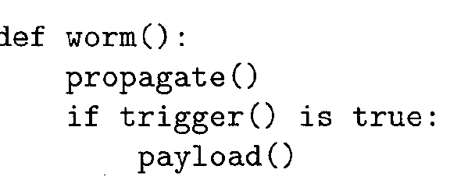
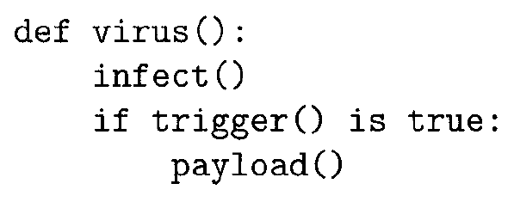
What are Worms?
Worms are self replicating, self propagating non-parasitic malware
Worms use buffer overflow vulnerability to spread without user intervention

Slide 3
Worms
Propagating by infecting other code is the domain of a virus;
Actively searching for vulnerable machines across a network makes a worm
Worms are classified by the primary method they use for transport.
A worm using instant messaging (IM) to spread is called an IM worm, and a worm using email is an email worm.

Slide 4
Infection Mechanism
Social engineering
Exploit technical weaknesses
if just viewing the email allows the worm's code to execute via a buffer overrun.
Buffer overruns between long-running network server processes on different machines

Slide 5
Infection Mechanism
Exploit existing, legitimate transactions.
For example, consider a worm able to watch and modify network communications, especially one located on a network server machine.
The worm can wait for legitimate transfers of executable files - file transfers, network filesystem use - and either substitute itself in place of the requested executable file, or insert itself into the requested file

Slide 6
Spreading Worms
Target Selection Strategies for Enhanced Targeting
Minimize re-infect effort
Scanning for targets in Parallel
May deliberately propagate slowly to avoid notice
surreptitious worms
Enhance Speed for increase in Infection rate
Use less overhead network Protocols like UDP
Slammer worm, for example, used the User Datagram Protocol (UDP) to infect SQL database servers using a buffer overflow.

Slide 7
Initial Seeding
Worms need to be injected into a network somehow. The way that a worm is initially released is called seeding
A single network entry point would be relatively easy to trace back to the worm author
An effective seeding method should be as anonymous and untraceable as possible, and distribute many instances of the worm into the network.

Slide 8
Initial Seeding
anonymity and volume are two desirable properties of propagation
Seeding can be done in following ways
Wireless Networks
Spam
Botnets
Several Other ways to access common network services

Slide 9
Scanning Strategies for Target Selection
Random Scanning - Code Red I
Localized Scanning - Code Red II
Hit-List Scanning
Avoid contention
Speed up initial spread
Permutation Scanning

Slide 10
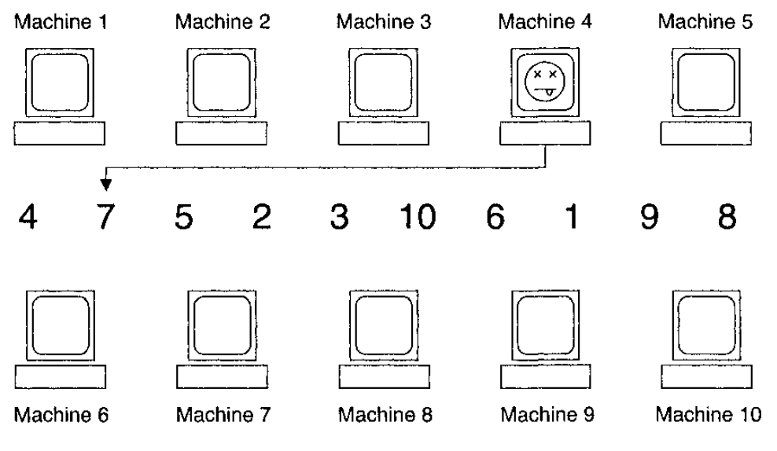
Permutation Scanning

Slide 11
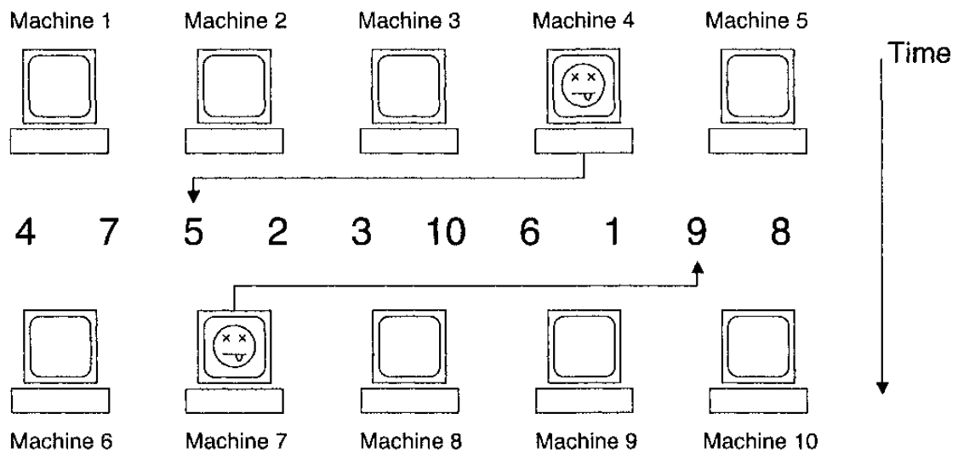
Permutation Scanning

Slide 12
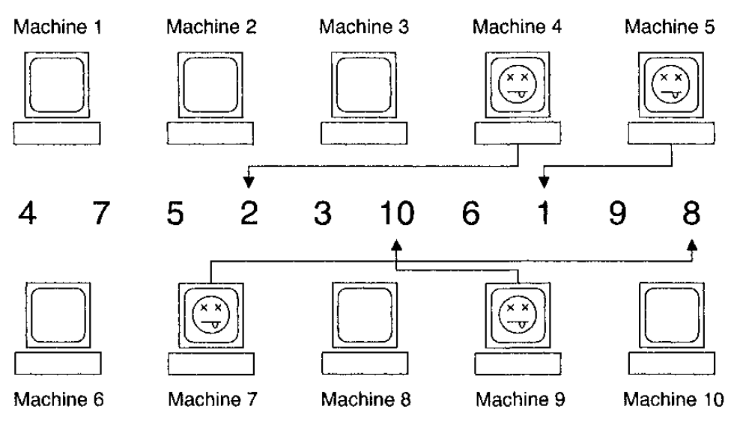
Permutation Scanning

Slide 13
Topological Scanning
Information on infected machines can be used to select new targets, instead of using a random search.
Passive Scanning
Look for Vulnerable IP addresses in eavesdropping
Sniff OS and Services
Network Traffic Patterns

Slide 14
Email Worms
These are topological worms
Loveletter.txt.vbs
Melissa (macro virus)
Nimda
MIME extensions were exploited
Sobig

Slide 15
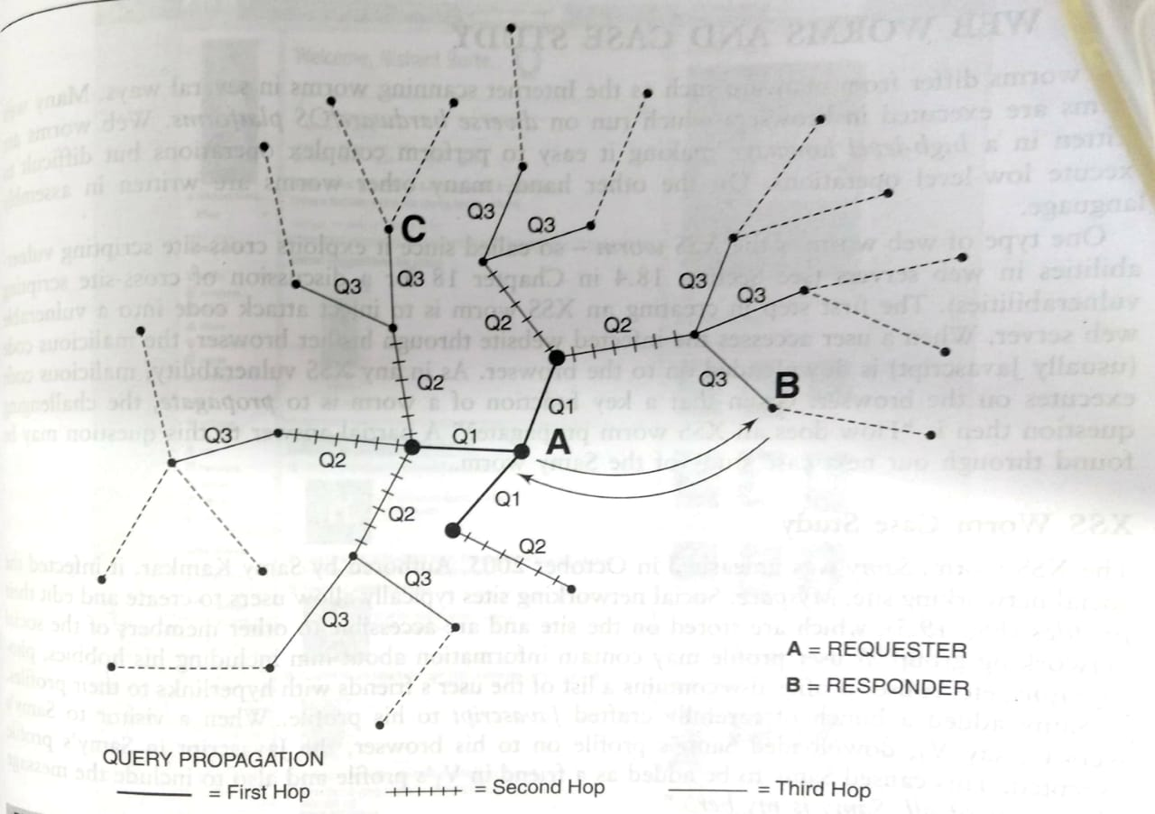
P2P Worms
Passive Worms – Send infected files on request
Active Worms – Exploit vulnerability in common software

Slide 16
Worm Propagation Model

Slide 17
Simple Epidemic Model
17
Assumptions
The population size (#hosts) is large
Any host has equal probability to contact any other hosts in system
Number of contacts is proportional to #infectious X #susceptible
infectious
susceptible
removed
Infectious (I)
contact
Susceptible (S)
Notes:
17

Slide 18
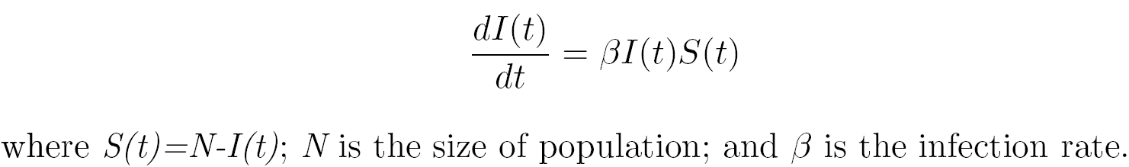
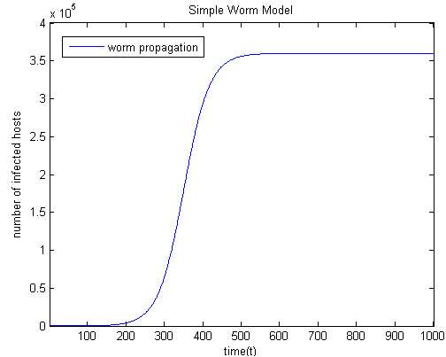
Classical Simple Epidemic Model
State transition
N - population of hosts
S(t) - susceptible hosts; I(t) - infectious hosts at time t
susceptible
infectious
Notes:
18

Slide 19
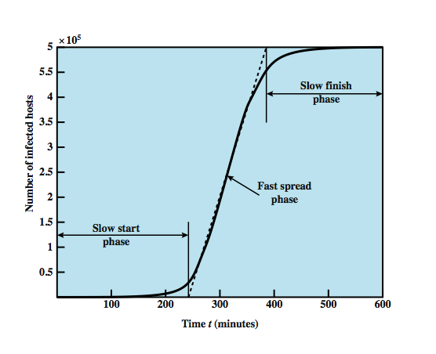
Characteristics of Worm Spreading
Worm growth: slow start, fast spread phase, slow decay
Speed-ups with more advanced probing techniques
Notes:
19

Slide 20
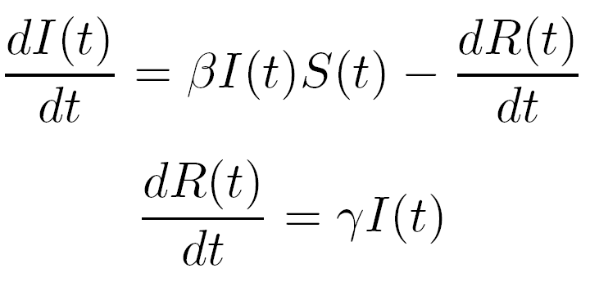
Classical General Epidemic Model (SIR)
State transition
N - population of hosts
S(t) - susceptible hosts
I(t) - infectious hosts
R(t) - removed from infectious at rate γ
susceptible
infectious
removed
Notes:
20

Slide 21
How to Mitigate the Worm Threat?
S(0) = N
β = λ / M
probe rate of worm
M total population (e.g. 232 for IPv4)
γ “removal” rate
1. Reduce # of susceptible hosts
(prevention)
2. Reduce rate of infection
(suppression)
3. Reduce # of infected hosts
(containment)
Notes:
21

Slide 22
Mitigating the Worm Threat
Prevention
This aims to reduce the size of the vulnerable population
Secure programming, applying software updates, AV protection
Patching
Generally, patches take days to release – only now that relatively reliable distribution networks for patches are springing up
Containment and suppression (the easiest)
Firewalls, Content Filtering, Automated Routing Blacklists, disconnecting infected machines
Notes:
22

Slide 23
Worm Detection
Signature-based worm detection
Generates a worm scan signature to prevent worm scans from entering a network/host
Payload-classification-based worm containment
Packet based checks
Threshold random walk scan detection
Exploits randomness in picking destinations to connect to (to detect scanning)
Rate limiting and rate halting
Limit or block outgoing traffic when a given threshold exceeded (for fast worms)
Notes:
23

